Slide 1
Books of the New Testament
www.turnbacktogod.com

Slide 2

Matthew
Link between Old and New Testaments
Jesus is the true Messiah, the fulfillment of Old Testament prophecies
A Jew writing to fellow Jews
Systematic use of Jesus’ sermons
Key chapters: 5-7 – Sermon on the Mount

Slide 3
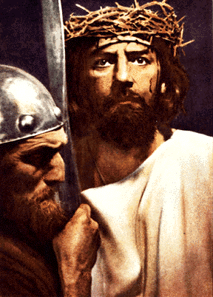
Mark
The gospel of action (emphasizes works more than words)
Writing to Romans
Starts with John the Baptist
Short and rugged gospel

Slide 4

Luke
Written for Theophilus, a Roman official
Christ is savior of every person, not Jews only
Reflects doctor's heart
Great joy
Gospel of prayer

Slide 5
John
Written to everyone
Established deity of Christ
Not so much on what Jesus did as what kind of person He was
Great themes: light, life, love, truth, the Father-Son relationship
John 17 -- High Priestly prayer

Slide 6

Gospel comparison
Matthew is longest; Mark is shortest
Only Matthew and Luke tell of Jesus' birth and childhood

Slide 7
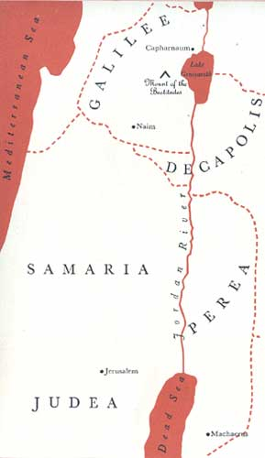
Gospel comparison
Geography of ministry:
  Matthew and Mark: Galilean ministry
  Luke: ministry in Perea
  John: ministry in Judea

Slide 8
Acts
Church history (acts of some of the Apostle – primarily Peter and Paul)
Paul’s 3 missionary journeys
Key chapters
  Acts 2 – Day of Pentecost
  Acts 15 -- pivotal decision

Slide 9
Romans
Righteousness of God and salvation through faith
Established Paul's credentials with church he had never visited
  missionary fund-raising letter
Luther / Wesley

Slide 10

1 Corinthians
Serious problems and disorder in a divided church
Immorality
Order in services 13:1; 14:33
Key chapter: 1 Corinthians 13 -- love chapter

Slide 11
2 Corinthians
Paul defends his ministry as an Apostle and as founder of Corinthian church, profound concern for young Christians 4:5
5:20-21

Slide 12
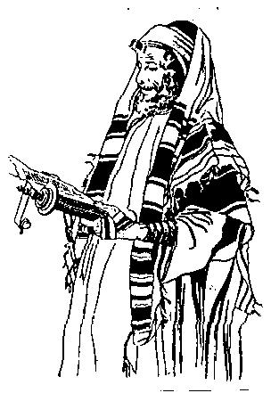
Galatians
Settle the debate: Must one submit to Jewish law, including circumcision, to become a Christian? (5:1)

Slide 13

Ephesians
A prison epistle
The grandeur of the Church
  Body of Christ 1:23, 4:16
  Temple of God 2:20-22
  Bride of Christ 5:23-32

Slide 14
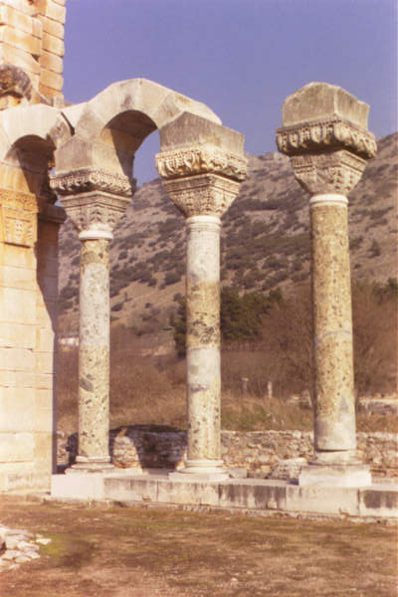
Philippians
A prison epistle.
Beware of legalism
Live joyfully in Christ in the midst of adverse circumstances

Slide 15
Colossians
Prison epistle
Against Gnosticism (superior knowledge)
  Believed in a ladder of deities
  Asceticism (isolation from the world and all luxury)
The deity and all-sufficiency of Christ

Slide 16
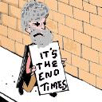
1 and 2 Thessalonians
Eschatology,
  Last things
  Christ’s Second Coming

Slide 17
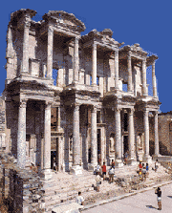
1 Timothy
Care of the church at Ephesus
Emphasizes godliness in a minister of Gospel
Beliefs and feelings about Church administration 4:12

Slide 18
2 Timothy
Paul's final letter
His dying shout of triumph
Tells Timothy to stand by his faith and to live by high convictions
“Last words from death row”

Slide 19
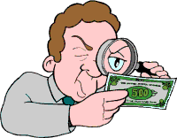
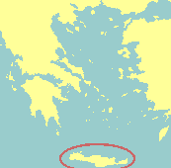
Titus
Warns against counterfeit Christians
Qualifications for church leaders
Concerning churches at Crete

Slide 20

Philemon
Letter from prison
On behalf of a runaway slave, Onesimus

Slide 21
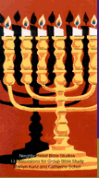
Hebrews
Written to persecuted Christian Jews tempted to deny their faith
Better: The superiority of Christ and faith in Him
Key chapter: Hebrews 11 -- Faith chapter

Slide 22
James
1:27 Good works and pure religion
The necessity of a living faith
Exposes subtle sins
  pride, gossip, aloofness, materialism and practical atheism
Proving your faith by your works

Slide 23

1 Peter
The Christian attitude or frame of mind in the midst of suffering
Emphasis on holiness

Slide 24

2 Peter
Affirms Second Coming
Cries out against evils of heresy and teachers of error
A prediction of apostasy

Slide 25

1 John
A letter written from Ephesus
If we are His, we will love one another and live righteously

Slide 26

2 John
Denounces false and heretical teachers
Walking in truth and love

Slide 27
3 John
Vast difference between good and bad behavior
Emphases:
  Prayer
  Faithful work in the Church
  Christian integrity
Hospitality toward itinerant ministers, v 11

Slide 28
Jude
The faith once for all delivered to the saints
A great doxology
Immoral character of heretics

Slide 29

Revelation
The grand finale
Visions about the future
Ultimate triumph of Christ and the New Heaven and New Earth

